Slide 1
Final Evaluation
DL & NLP pour le diagnostic
Romain Lhotte & Paul Dubois

Slide 2
Grade of this final evaluation
75% performance (it’s not a Kaggle, you have to send us tensors and we will run the evaluation pipeline ourselves at the end). C.f. the example submission notebook.
25% oral presentation on the 4th of March

Slide 3
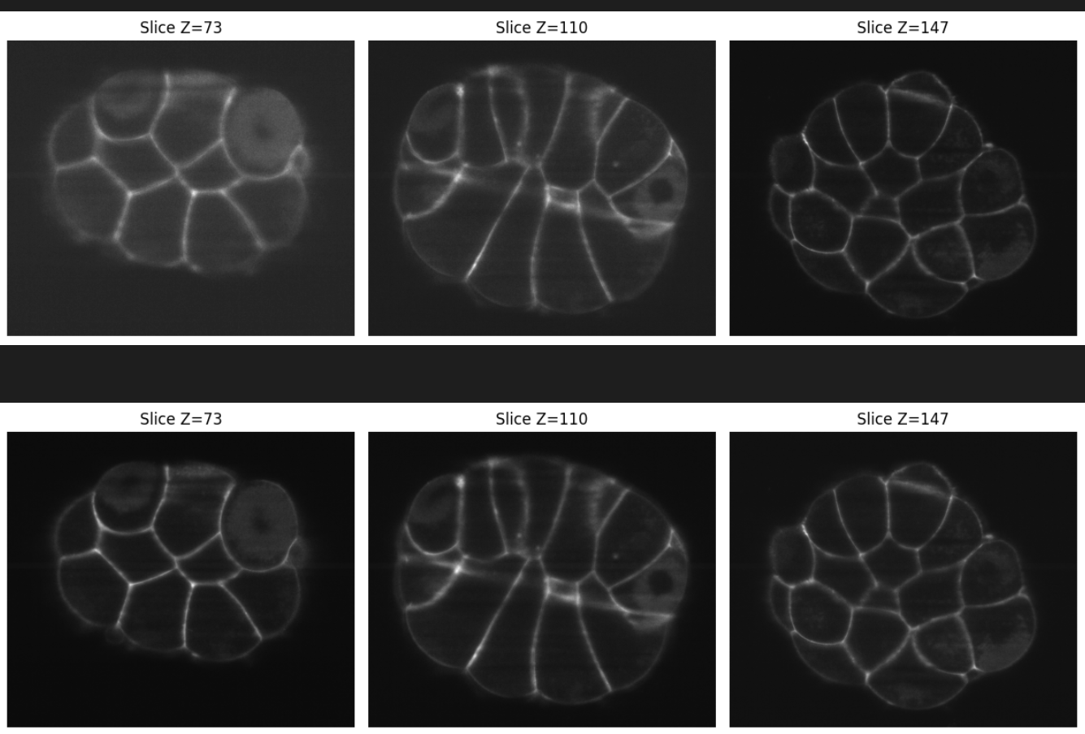
Context
3D images in microscopy are sometimes not of great resolution for multiple reasons.
We give you pairs of real microscopy images (low-resolution & high resolution). You must learn how to improve the resolution.
Figure1: Example of a data pair (only 3 slices are shown) of the training set (image_15_membrane_angle.tif)

